Slide 1
Traffic light controller
Submitted by : PARISHA AGGARWAL (2021eeb1049@iitrpr.ac.in)

Slide 2
Introduction
Modelled in Verilog, traffic light controller synthesized is functional to operate at junction of highway and a country road.
Traffic light controller gives highest priority to Highway, takes input as clock, reset_button, and sensor. Highway light and country light are the outputs.
reset_button – we are using an active low reset button, as soon as the reset button is active highway light is turned green and country light is turned red.
Sensor – sensor is high when it detects the vehicles at country road, else it remains low
Clock – we are using a 50 Hz (20 ms) clock
In our model there are four possible states –
HG_CR – highway light is green, and country light is red
HY_CR – highway light is yellow, and country light is red
HR_CG – highway light is red, and country light is green
HR_CY – highway light is red, and country light is yellow state HG_CR is default state or state with highest priority.

Slide 3
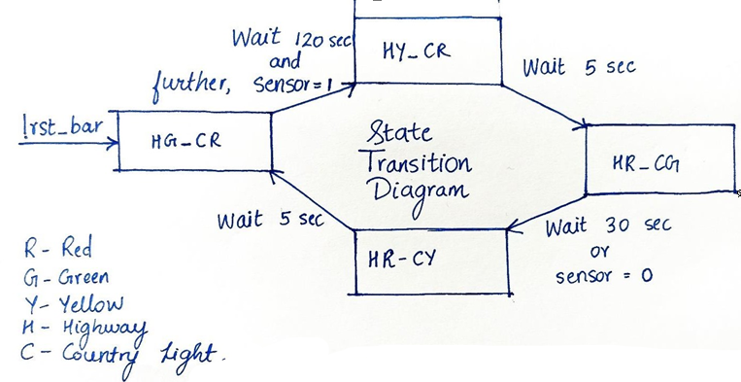
State Transition Diagram

Slide 4
Explanation
We will start with present state as HG_CR. It will remain at HG_CR until sensor becomes high
illustrating vehicles at country road, which turns the state to HY_CR, this state is persisted for five seconds letting the vehicles at highway to stop for awaiting red light at highway. Then as soon as five seconds are over, we move to HR_CG. Here comes the interesting part, this state can be persisted for maximum of thirty seconds, we move to next state as soon as thirty seconds are over or sensor goes down, whatever happens first giving priority to highway. If the sensor goes down before thirty seconds or thirty seconds are over, we move to HR_CY. Yellow light of country side is on, again we will remain at this state for five seconds, letting the vehicles settle.
Now imagine a situation, when we are at HR_CG, thirty seconds are over, but all the vehicles haven’t passed that implies sensor will be high. We will move to HR_CY, then to HG_CR with sensor high. In this situation, giving priority to highway, highway light will be green for minimum of two minutes, irrespective of sensor.

Slide 5
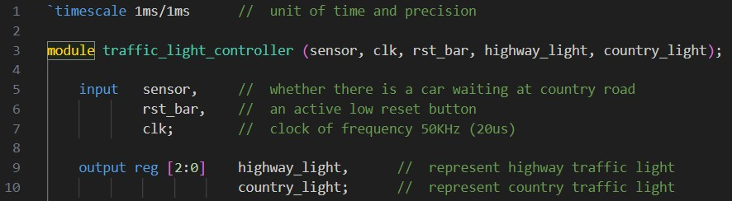
Input and Output ports
Timescale sets units of time as 1ms with precision of 1ms.
Module is made with name ‘traffic_light_controller’, and input & output ports are declared first.

Slide 6
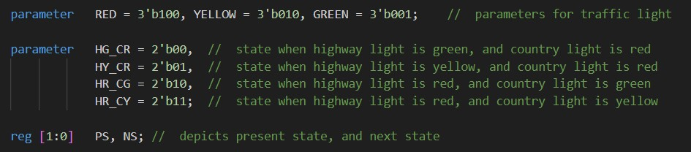
Parameters
Parameters for traffic light and state, as depicted earlier along with register for present state, and next state.

Slide 7
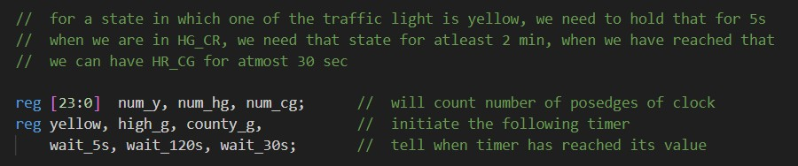
Timers
Registers for counting, basically for timers of 5, 30 and 120 seconds

Slide 8
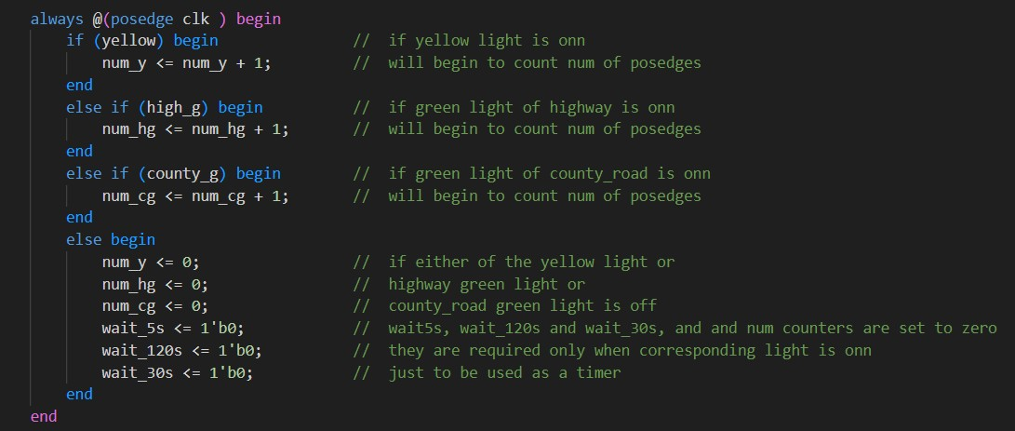
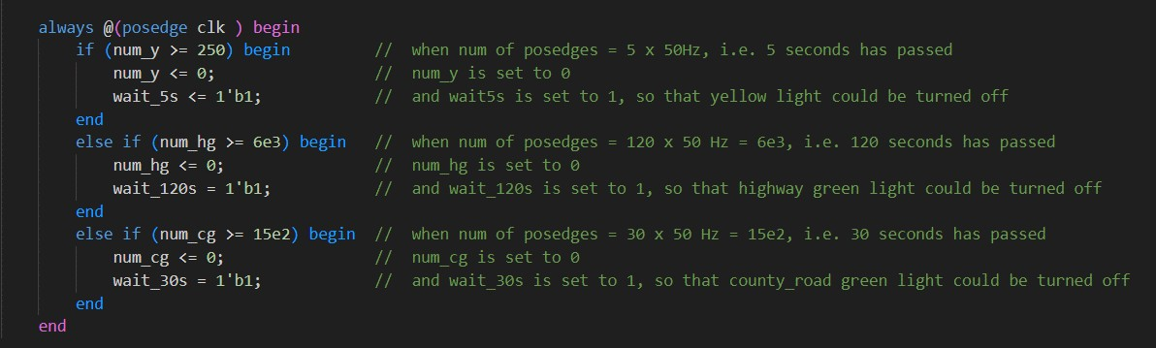
Count the number of posedges of clock, based on which at which state the module is in.
Conditions to set the timer based on number of posedges counted.

Slide 9
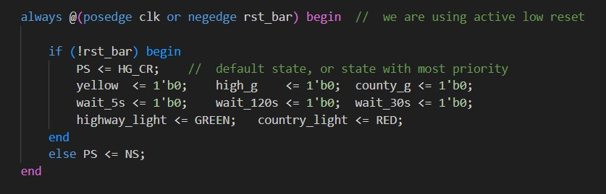
Reset button
Reset function, reset is active low, so whenever negative edge of rst_bar comes and rst_bar is low it moves to HG_CR, reseting all timer registers to 0, and turning highway light to green, country light to red.

Slide 10
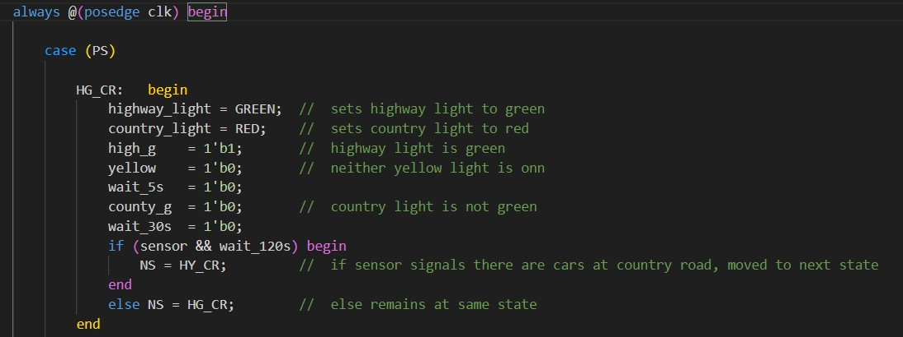
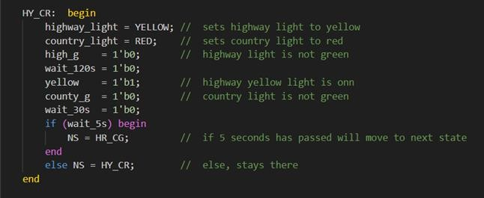
Switch case
Moves to next state HY_CR when both wait_120s and sensor are high
Moves to next state HR_CG after waiting for 5 seconds

Slide 11
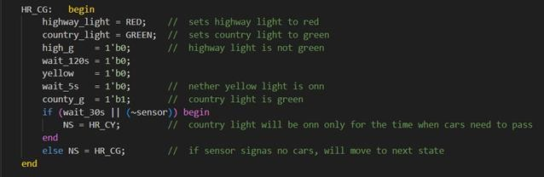
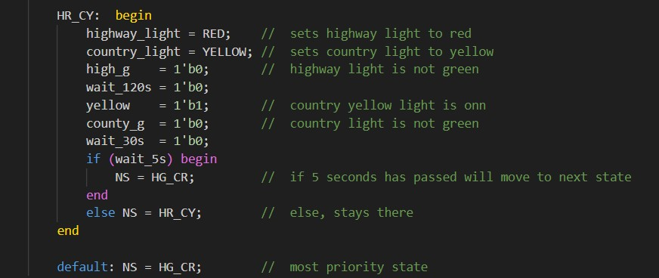
Moves to next state when either sensor is low, or wait_30s is high
Moves to next state after waiting for 5 seconds, and default is HG_CR

Slide 12
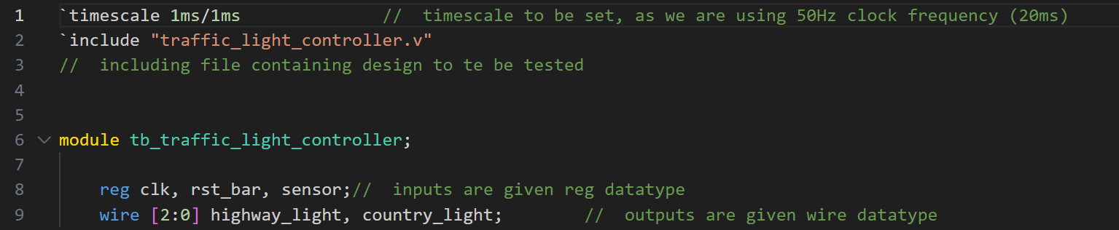
Testbench
Input and Output ports
Setting the timescale, including the file containing design under test Input ports are to be declared reg type and output as wire

Slide 13
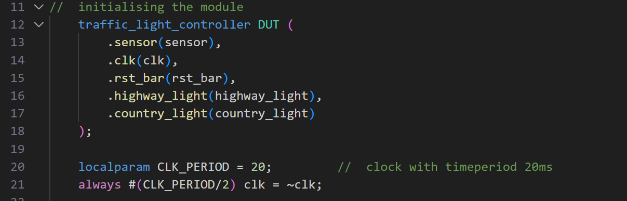
Module instantiation & clock
Module is instantiated with name ‘DUT’, input and output parameters are fed. We are using clock of 50Hz, hence declared using localparam.

Slide 14
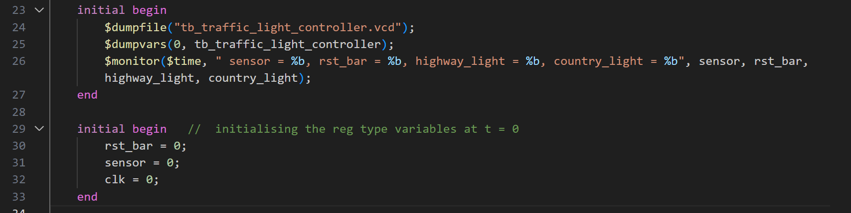
Initialising input values & dumping
Dumping the file to ‘.vcd’ and variables to monitor using dumpvars. Monitor to see the variables at terminal and all the input values are set to 0, at t = 0.

Slide 15
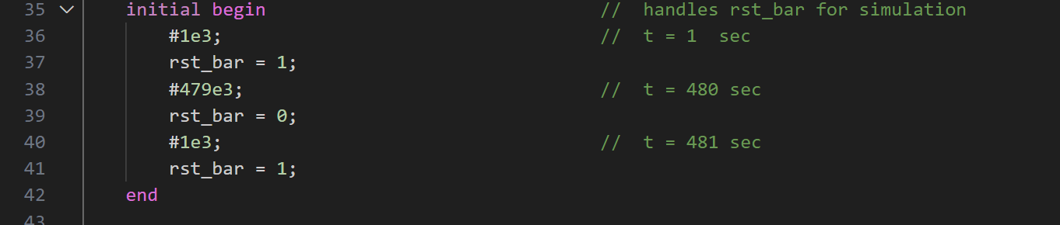
Reset button
Reset button becomes active at time t = 480 s, else inactive

Slide 16
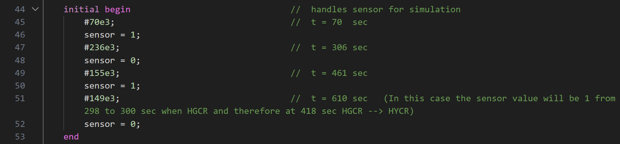
Sensor
Then finished using $finish

Slide 17
Synthesising and output
Synthesised using command – iverilog -o <destination_file.vvp> <source_file.v>
After executing this command, a .vvp file is synthesised along with a .vcd file with file name as in
$dumpfile()
Then accessed using command – vvp <destination_file.vvp> Then the following is displayed at terminal.
Result -> Output matched with the expected output.

Slide 18
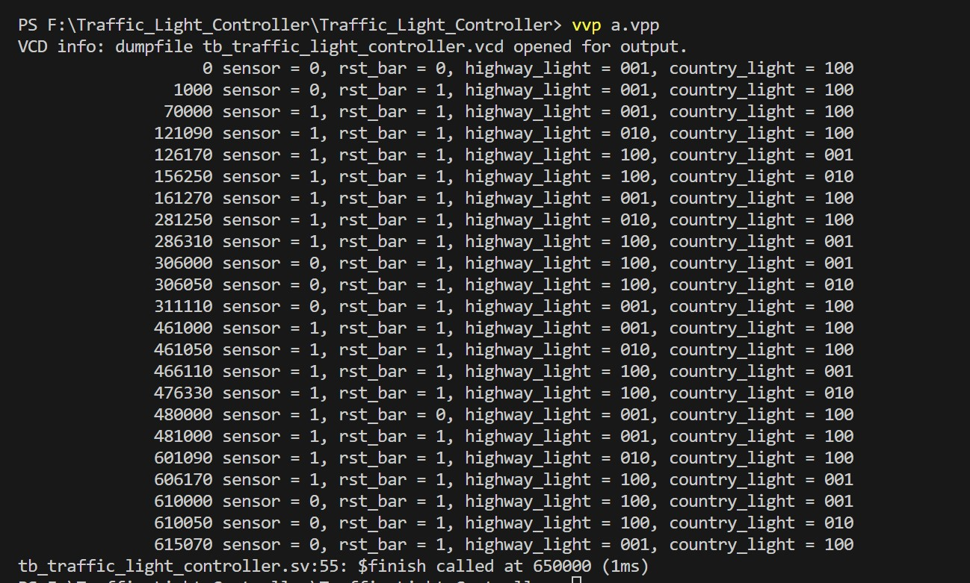

Slide 19
Conclusion
The traffic light controller for a highway and country road needs to efficiently manage the flow of traffic, taking into account factors such as traffic volume, priority rules, and safety considerations.
The Verilog code for the controller would involve defining the behaviour and interaction of these components, as well as the decision-making logic for determining when to change the traffic lights.
Here, we have used it to define the various components of the system, including the traffic lights, sensors, timers, and control logic.

